Slide 1

ASSIGENMENT ABOUT
Design Thinking
BBA 1st SEM (2022-23)
Submitted By-
Shankh Bansal
Submitted To-
Dr. Amber Tiwari

Slide 2
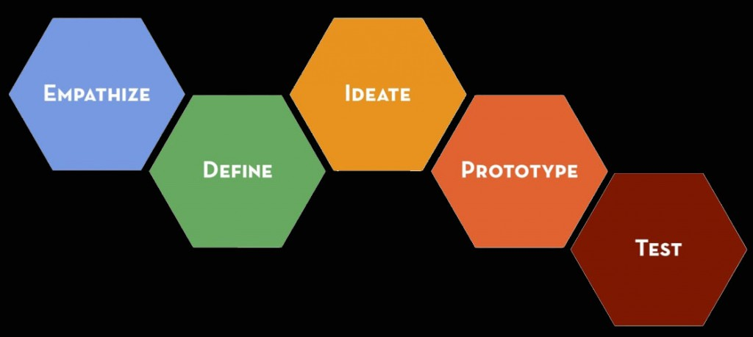
Solution steps

Slide 3
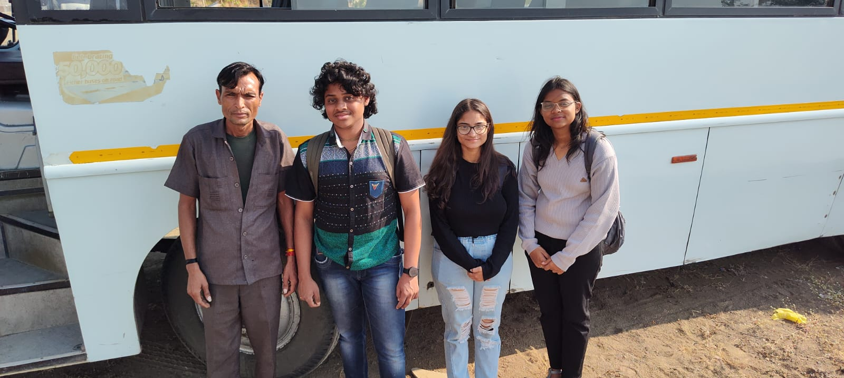
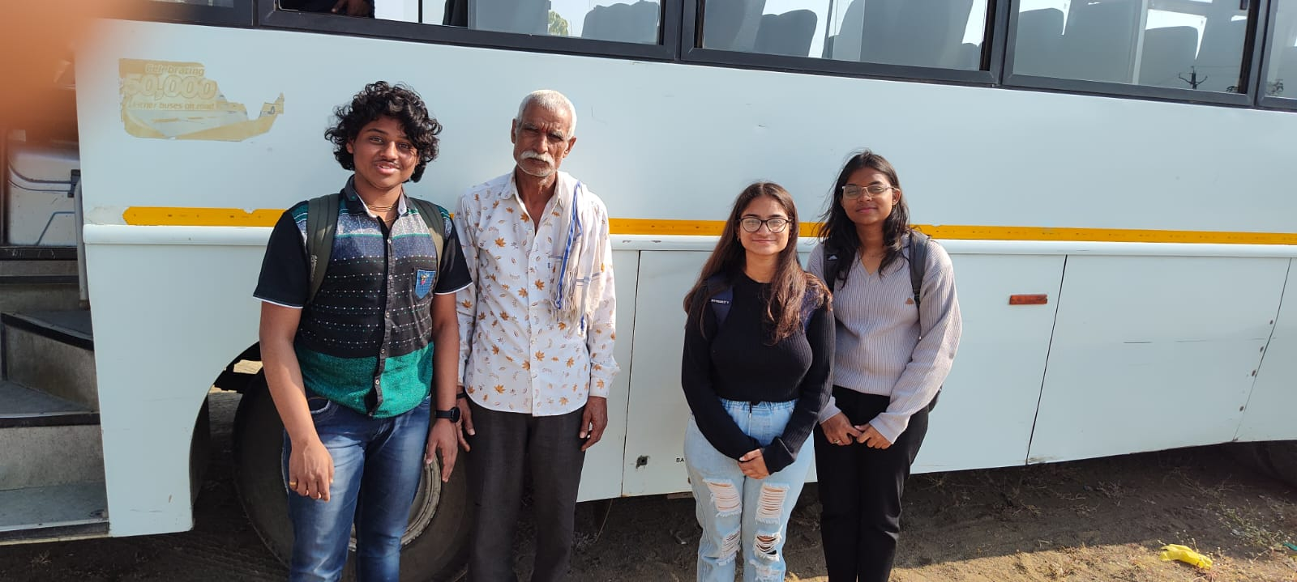
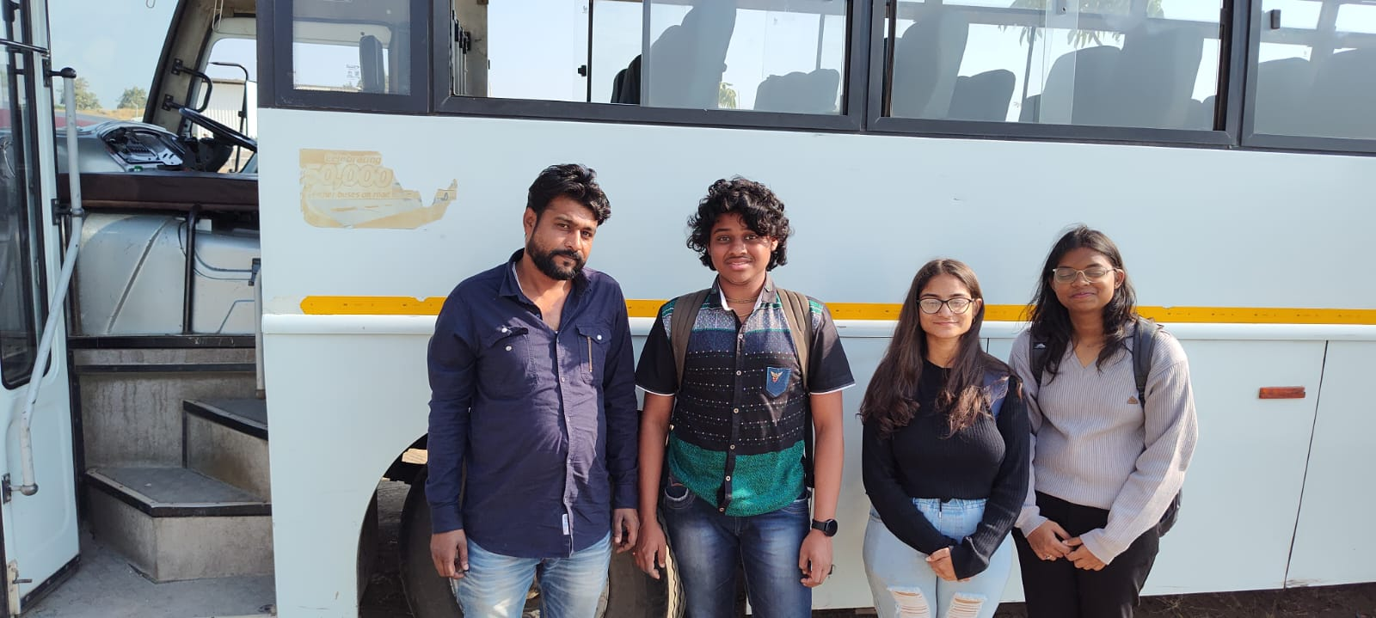
Interviews we took

Slide 4
Empathies
What is their problem?
[all the buses are not having washroom facility inside the bus?]
Whom am I making this for?
[all the people who travel from bus for going to collage , office , school]
What do these people do?
[these people are basically- teenagers, youth, tourist, office folks ]

Slide 5
Advantages and disadvantages of having washroom in bus.
Advantages
it will create more employment.
it will increase people point of view for bus.
it can be used a strong point to bring more attraction towards the bus.
Disadvantages
It will cut off few members as it will occupies space.
It requires a proper maintenance in a regular period.
They are poorly managed and many of them are for employee use only .

Slide 6
Define
What are the users need?
[To have washroom facility inside the bus.]
What are their problem?
[people find it difficult to ensure a clean washroom around them.]
What are their challenges?
[construct a fully usable toilet in limited space]
What are the insights we can use?
[we can construct a toilet which will become helping hand for many people.]

Slide 7
What is the biggest challenge?
If the bus contain a washroom, it will require a large amount of water which will reduce the bus efficiency.
Solution-
The washroom shall be more tilted toward air suction not on water which will reduce the weight , expenses and improve its efficiency.
Example- washrooms of airplanes.

Slide 8
Ideate
solutions
[All the buses shall contain a washroom.]
Ideas
[we shall create a washroom which should be fully functional in less expanses .]
Potential matches
[to create a ditto same washroom as on an airplane.]

Slide 9
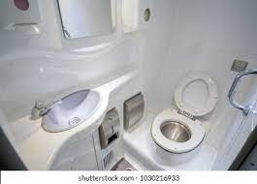
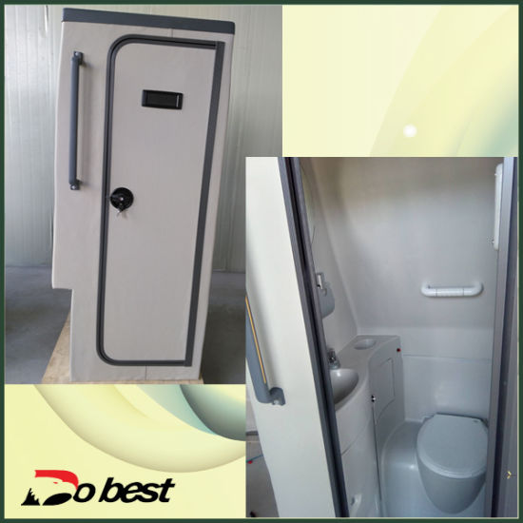
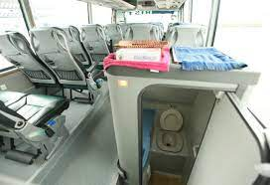
Some glimpse of imagination

Slide 10
prototype
Who can excess to the washroom
[All the member travelling in the bus can use the washroom free of cost.]
How will it look like?
[It will be in the back side of the bus, and it will look like a normal washroom.]

Slide 11
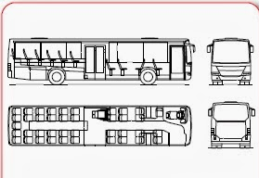
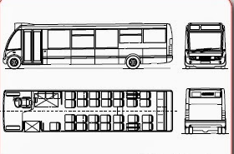
The Innovation we want

Slide 12
Test
It your prototype working?
[It is under testing phase]
[There is no disadvantages of this product, but it increases our work like washing , cleaning , maintaining etc.]
Is it easily available for all?
[All the person can easily use the washroom without any extra charge.]
Are there any flows in the product you discovered?

